Slide 1


Spotify
Predicting Popularity Using Data
Quin Yuter, Howie Huang, Pablo Gonzalez, Zach Ruud
Notes:
Quin

Slide 2

Notes:
Quin

Slide 3





Upgrade
Group5
Our Goal
Our Goal
Our Goal
Data
Data
Data
Agenda
Agenda
Agenda
Our Team
Lit Review
Lit Review
Lit Review
EDA
EDA
EDA
Feature Engineering
Feature Engineering
Feature Engineering
Modeling
Modeling
Modeling
Conclusions
Conclusions
Gallery
Recommendations
Recommendations
Pricing
Quin Yuter
Zach Ruud
Pablo Gonzalez
Howie Huang
References
References
Contact Us
Notes:
Quin

Slide 4
k
Upgrade
Group5
Our Goal
Our Goal
Our Goal
Data
Data
Data
Agenda
Agenda
Agenda
Our Goal
Lit Review
Lit Review
Lit Review
EDA
EDA
EDA
Using data, we hope to predict if a song will be popular. Our target variable, “popularity”, is on a scale of 1-100, with 1 meaning a song is not popular and 100 meaning a song is as popular as it can be.
Feature Engineering
Feature Engineering
Feature Engineering
Modeling
Modeling
Modeling
Conclusions
Conclusions
Gallery
Play
Follow
Recommendations
Recommendations
Pricing
References
References
Contact Us
Notes:
Quin

Slide 5
Data Overview
Upgrade
k
Group5
Our Goal
Our Goal
Our Goal
Variable Name | Type | Range (If Applicable)
track_id | char
artists | char
album_name | char
track_name | char
duration | num
explicit | boolean
danceability | num | [0, 1]
energy | num | [0, 1]
key | num
Loudness (db) | num
Variable Name | Type | Range (If Applicable)
mode | num | 0, 1
speechiness | num | [0, 1]
acousticness | num | [0, 1]
instrumentaness | num | [0, 1]
liveness | num | [0, 1]
valence | num | [0, 1]
tempo (BPM) | num
time_signature | num | 3, 4, 5, 6, 7
track_genre | char
popularity | num | 1-100
Data
Data
Data
Agenda
Agenda
Agenda
Lit Review
Lit Review
Lit Review
EDA
EDA
EDA
Feature Engineering
Feature Engineering
Feature Engineering
Modeling
Modeling
Modeling
Conclusions
Conclusions
Gallery
Recommendations
Recommendations
Pricing
References
References
Contact Us
Notes:
Quin

Slide 6
k
Upgrade
Group5
Our Goal
Agenda
Our Goal
Our Goal
Data
Data
Data
Agenda
Agenda
Agenda
Lit Review
Exploratory Data Analysis
Feature Engineering
Modeling
Deployment
Conclusions
Recommendations
References
Lit Review
Lit Review
Lit Review
EDA
EDA
EDA
Feature Engineering
Feature Engineering
Feature Engineering
Modeling
Modeling
Modeling
Conclusions
Conclusions
Gallery
Recommendations
Recommendations
Pricing
References
References
Contact Us
Notes:
Quin

Slide 7
k
Upgrade
Group5
Our Goal
Our Goal
Our Goal
Data
Data
Data
Agenda
Agenda
Agenda
Lit Review
Lit Review
Lit Review
EDA
EDA
EDA
Literature Review
Feature Engineering
Feature Engineering
Feature Engineering
Modeling
Modeling
Modeling
Conclusions
Conclusions
Gallery
Recommendations
Recommendations
Pricing
References
References
Contact Us
Notes:
Quin

Slide 8
k
Upgrade
Group5
Our Goal
Our Goal
Our Goal
Literature Review
Data
Data
Data
Agenda
Agenda
Agenda
AI is used in Music Production, but faces plagiarism issues. MiRA tools help address this.
ML models use acoustic features to predict music popularity, which aids artists and music executives.
Getting music into multimodal data sets proves to be challenged (ethics, synchronization, balance)
Recommendation algorithms reinforce mainstream music, limiting diversity
NLP and Sentiment analysis of lyrics reveal a societal shift to negativity in music.
Lit Review
Lit Review
Lit Review
EDA
EDA
EDA
Feature Engineering
Feature Engineering
Feature Engineering
Modeling
Modeling
Modeling
Conclusions
Conclusions
Gallery
Recommendations
Recommendations
Pricing
References
References
Contact Us
Notes:
Quin

Slide 9
k
Upgrade
Group5
Our Goal
Our Goal
Our Goal
Data
Data
Data
Agenda
Agenda
Agenda
Lit Review
Lit Review
Lit Review
EDA
EDA
EDA
Exploratory Data Analysis
Feature Engineering
Feature Engineering
Feature Engineering
Modeling
Modeling
Modeling
Conclusions
Conclusions
Gallery
Recommendations
Recommendations
Pricing
References
References
Contact Us
Notes:
Quin

Slide 10
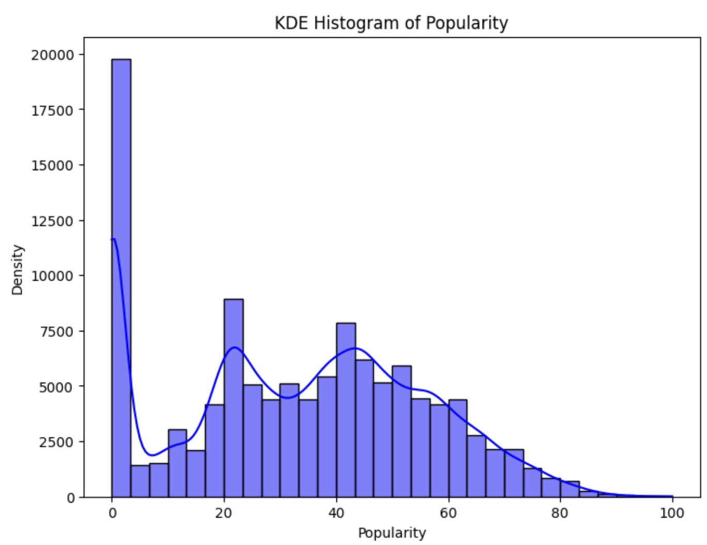
k
Upgrade
Group5
Our Goal
Our Goal
Our Goal
Data
Data
Data
Agenda
Agenda
Agenda
Lit Review
Lit Review
Lit Review
EDA
EDA
EDA
Feature Engineering
Feature Engineering
Feature Engineering
Modeling
Modeling
Modeling
Conclusions
Conclusions
Gallery
Recommendations
Recommendations
Pricing
References
References
Contact Us
Notes:
Quin

Slide 11
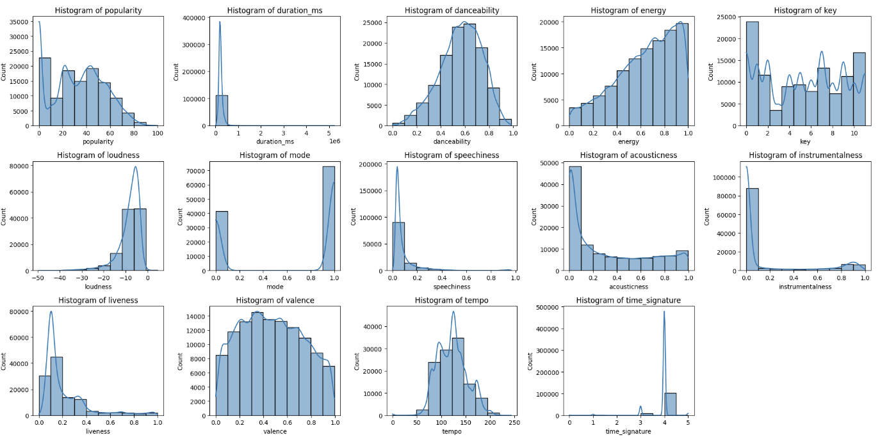
k
Upgrade
Group5
Our Goal
Our Goal
Data
Data
Agenda
Agenda
Lit Review
Lit Review
EDA
EDA
Feature Engineering
Feature Engineering
Modeling
Modeling
Conclusions
Gallery
Recommendations
Pricing
References
Contact Us
Notes:
Quin

Slide 12
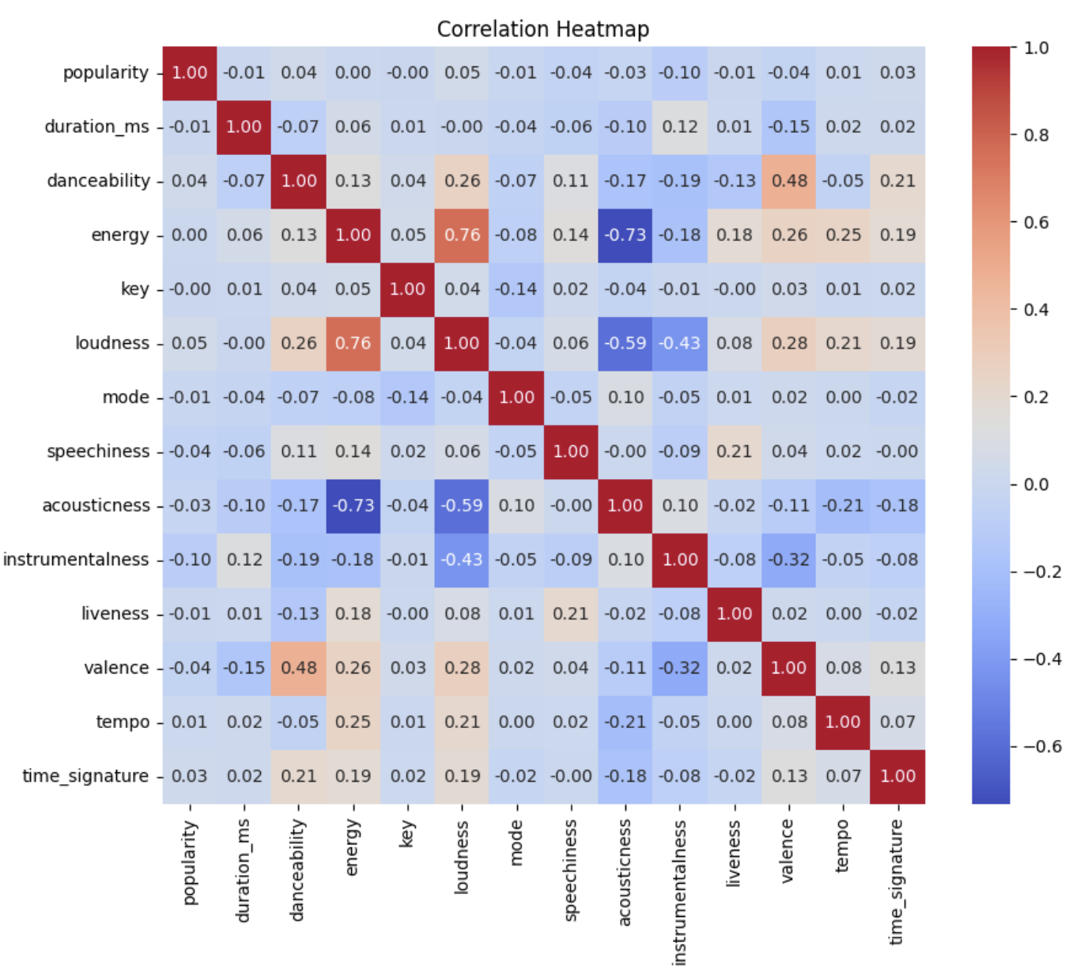
k
Upgrade
Group5
Our Goal
Our Goal
Data
Data
Agenda
Agenda
Lit Review
Lit Review
EDA
EDA
Feature Engineering
Feature Engineering
Modeling
Modeling
Conclusions
Gallery
Recommendations
Pricing
References
Contact Us
Notes:
Quin

Slide 13
k
Upgrade
Group5
Our Goal
Our Goal
Data
Data
Agenda
Agenda
Lit Review
Lit Review
EDA
EDA
Feature Engineering
Feature Engineering
Feature Engineering
Modeling
Modeling
Conclusions
Gallery
Recommendations
Pricing
References
Contact Us
Notes:
Howie

Slide 14
k
Upgrade
Group5
Our Goal
Feature Engineering
Our Goal
Data
Data
Agenda
Agenda
Lit Review
Drop Columns: track_id, artists, album_name, track_name, time_signature
Scaler: Min-max scaler
Transformation: yeo-johnson
Lit Review
EDA
EDA
Feature Engineering
Feature Engineering
Modeling
Modeling
Conclusions
Gallery
Recommendations
Pricing
References
Contact Us
Notes:
Howie

Slide 15
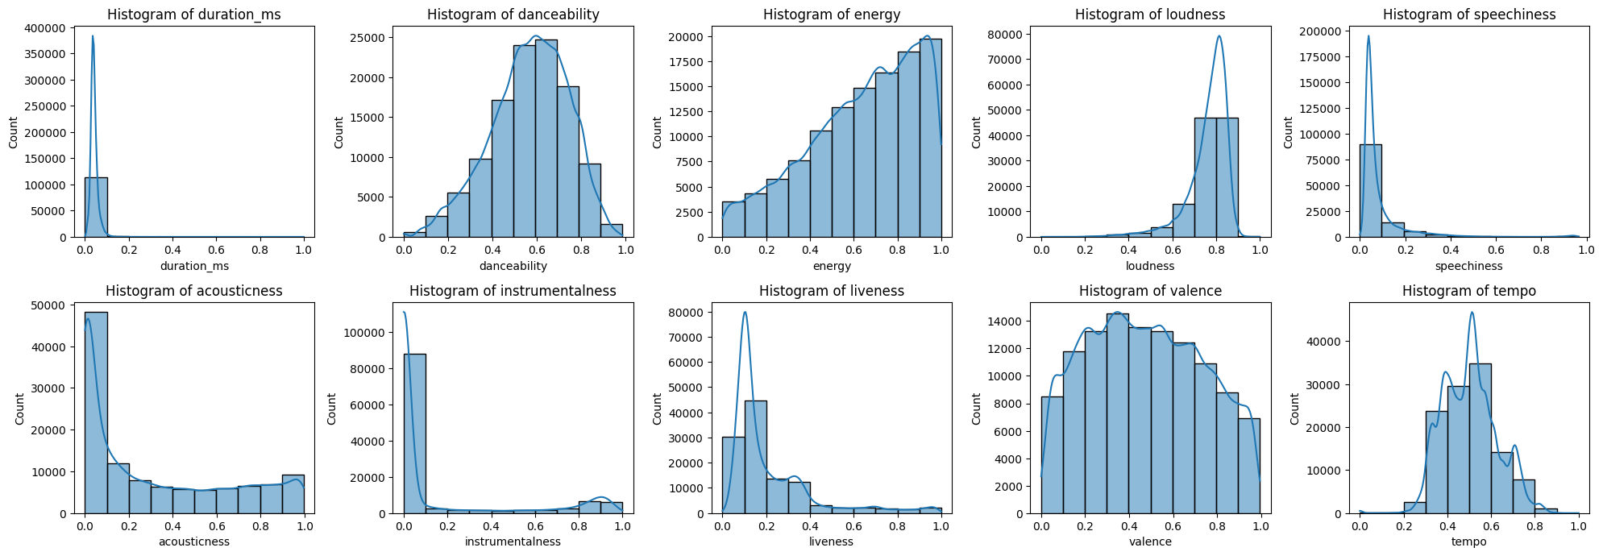
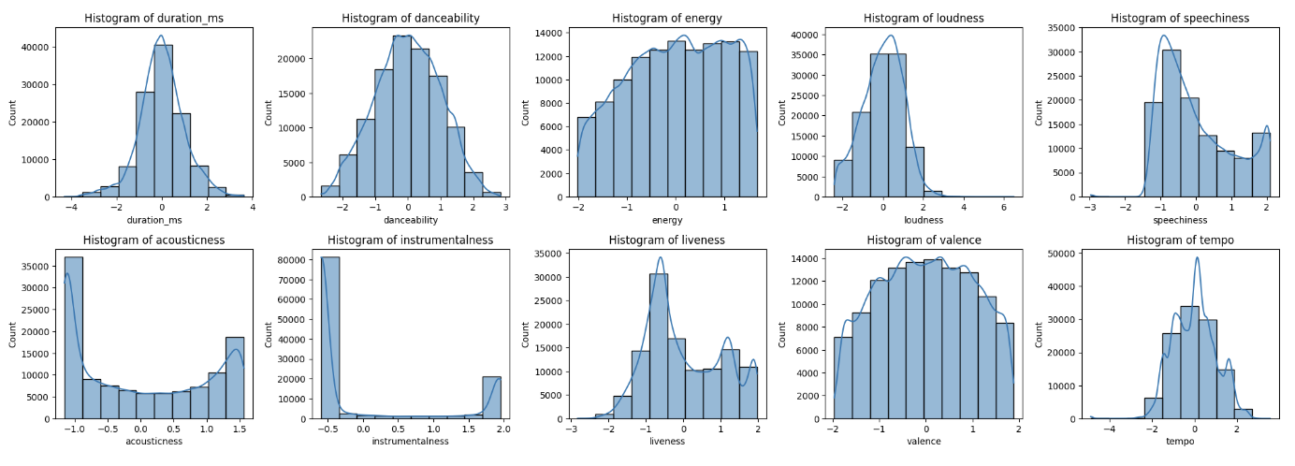
k
Upgrade
Group5
Our Goal
BEFORE
Our Goal
Data
Data
Agenda
Agenda
Lit Review
Lit Review
EDA
EDA
Feature Engineering
Feature Engineering
AFTER
Modeling
Modeling
Conclusions
Gallery
Recommendations
Pricing
References
Contact Us
Notes:
Howie

Slide 16
k
Upgrade
Group5
Our Goal
Our Goal
Track Genre Binning
Data
Data
Agenda
Agenda
Lit Review
Lit Review
Type 1 - Electronic and Dance
Type 2 - Rock, Alternative and Metal
Type 3 - Pop, Urban and Mainstream
Type 4 - Classical, Instrumental and Chill
Type 5 - World, Traditional, Folk, Media and Niche
EDA
EDA
Feature Engineering
Feature Engineering
Modeling
Modeling
Conclusions
Gallery
Recommendations
Pricing
References
Contact Us
Notes:
Howie

Slide 17
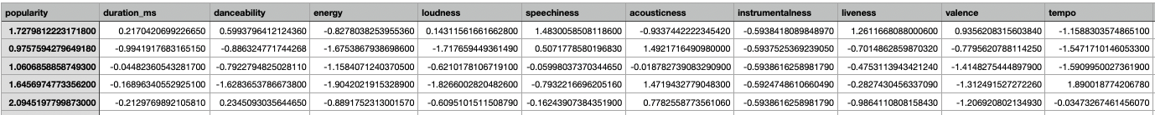
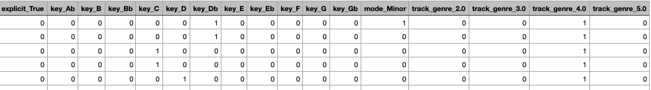
Final Data
Notes:
Howie

Slide 18
k
Upgrade
Group5
Our Goal
Our Goal
Data
Data
Agenda
Agenda
Lit Review
Lit Review
EDA
EDA
Modeling
Feature Engineering
Feature Engineering
Modeling
Modeling
Conclusions
Gallery
Recommendations
Pricing
References
Contact Us
Notes:
Pablo

Slide 19
k
Upgrade
Group5
Our Goal
Our Goal
Four Models
Data
Data
Agenda
Agenda
Lit Review
Lit Review
Decision Tree
Random Forest
Gradient Boosted Tree
Ensemble Learning
EDA
EDA
Feature Engineering
Feature Engineering
Modeling
Modeling
Conclusions
Gallery
Recommendations
Pricing
References
Contact Us
Notes:
Pablo

Slide 20
k
Upgrade
Group5
Our Goal
Our Goal
First Attempt
Data
Data
Agenda
Agenda
Lit Review
Lit Review
Regression Models
Poor Performance (~0.25 R^2)
Needed to Find Solution
EDA
EDA
Feature Engineering
Feature Engineering
Modeling
Modeling
Conclusions
Gallery
Recommendations
Pricing
References
Contact Us
Notes:
Pablo

Slide 21
k
Upgrade
Group5
Our Goal
Our Goal
Solution
Data
Data
Agenda
Agenda
Lit Review
Lit Review
Create Popularity Flag
75th percentile and Above is Deemed Popular
Poor Recall Score
Undersample Larger Set
EDA
EDA
Feature Engineering
Feature Engineering
Modeling
Modeling
Conclusions
Gallery
Recommendations
Pricing
References
Contact Us
Notes:
Pablo

Slide 22
k
Upgrade
Group5
Our Goal
Our Goal
Decision Tree
Data
Data
Agenda
Agenda
Hyperparameters
Criterion (gini, entropy)
Function to measure the quality of the split
Max_depth (3, 5)
Depth of each tree
Min_sample_split (2,5)
Minimum number of samples used to split a node
Min_sample_leaf (1,2)
Minimum amount of samples needed to be at a leaf node
Max_features (sqrt, log2)
Features to consider when looking for best split
Lit Review
Lit Review
EDA
EDA
Feature Engineering
Feature Engineering
Modeling
Modeling
Conclusions
Gallery
Recommendations
Pricing
References
Contact Us
Notes:
Pablo

Slide 23
k
Upgrade
Group5
Our Goal
Our Goal
Decision Tree
Data
Data
Agenda
Agenda
Results
Hyperparameters:
Criterion: Gini
Max_depth: 5
Max_features: log2
Min_samples_leaf: 2
Min_samples_split: 2
Lit Review
Metric | Score
Accuracy | 0.5693
Precision | 0.5493
Recall | 0.8263
F-1 | 0.6599
Lit Review
EDA
EDA
Feature Engineering
Feature Engineering
Modeling
Modeling
Conclusions
Gallery
Recommendations
Pricing
References
Contact Us
Notes:
Pablo

Slide 24
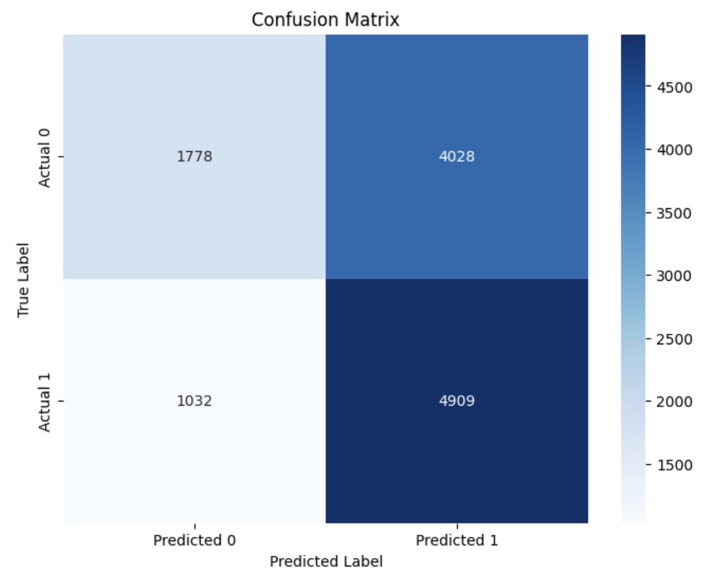
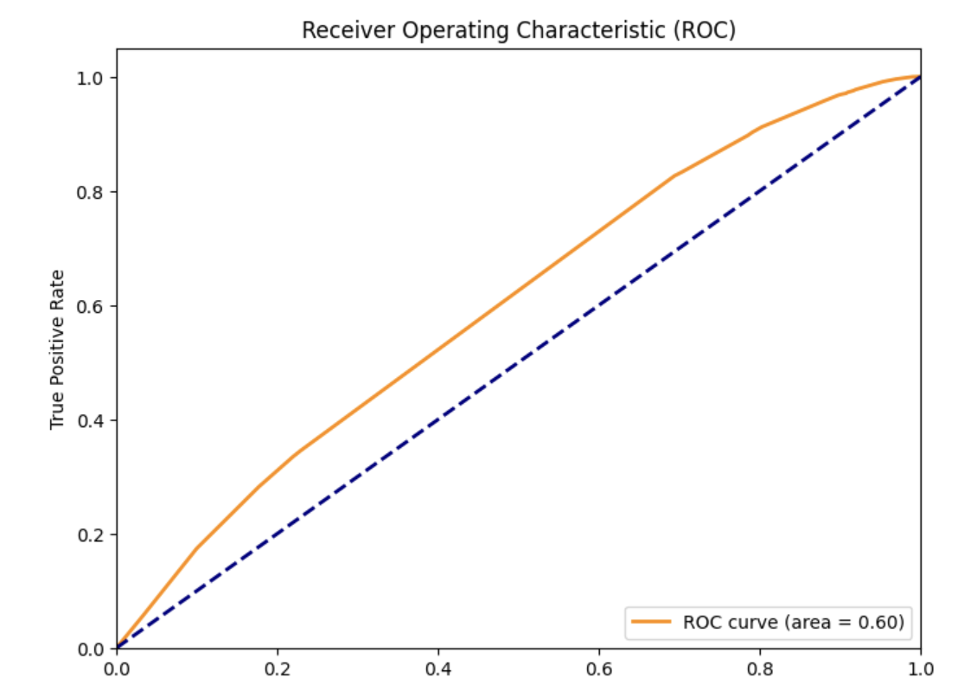
k
Upgrade
Group5
Our Goal
Our Goal
Decision Tree
Data
Data
Agenda
Agenda
Lit Review
Lit Review
EDA
EDA
Feature Engineering
Feature Engineering
Modeling
Modeling
Conclusions
Gallery
Recommendations
Pricing
References
Contact Us
Notes:
Pablo

Slide 25
k
Upgrade
Group5
Our Goal
Random Forest
Our Goal
Data
Data
Hyperparameter Tuning
max_depth: [10, 20]
Controls the maximum depth of each tree.
min_samples_split: [20, 50]
Minimum number of samples required to split an internal node.
min_samples_leaf: [10, 40]
Minimum number of samples in a leaf node.
n_estimators: [50, 100]
Number of trees in the forest.
criterion: ['gini', 'entropy']
Determines how splits are made in each tree.
Agenda
Agenda
Lit Review
Lit Review
EDA
EDA
Feature Engineering
Feature Engineering
Modeling
Modeling
Conclusions
Gallery
Recommendations
Pricing
References
Contact Us
Notes:
Zach

Slide 26
k
Upgrade
Group5
Our Goal
Random Forest
Our Goal
Data
Data
Agenda
Agenda
Lit Review
Results
Hyperparameters:
Max Depth = 20
Criterion= Gini
Min Samples Leaf = 10
Min Samples Split = 20
N Estimators = 100
Metric | Score
Accuracy | 0.703754
Precision | 0.693262
Recall | 0.742973
F-1 | 0.717257
Lit Review
EDA
EDA
Feature Engineering
Feature Engineering
Modeling
Modeling
Conclusions
Gallery
Recommendations
Pricing
References
Contact Us
Notes:
Zach

Slide 27
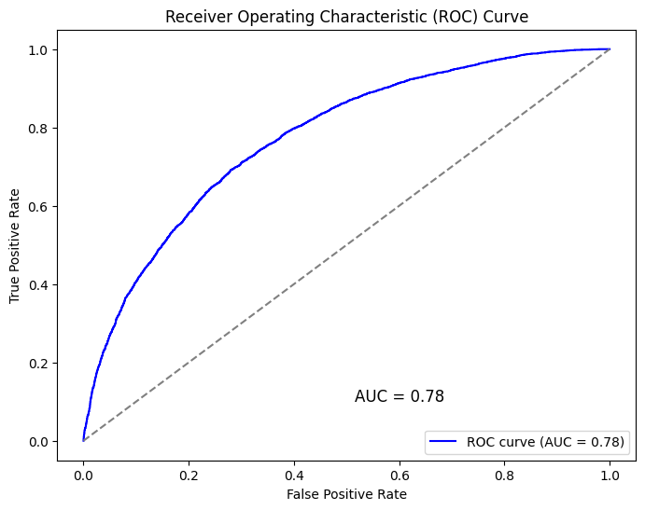
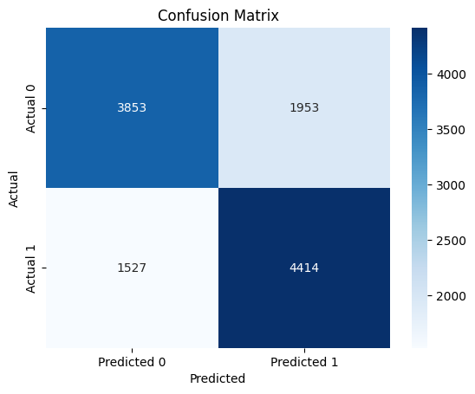
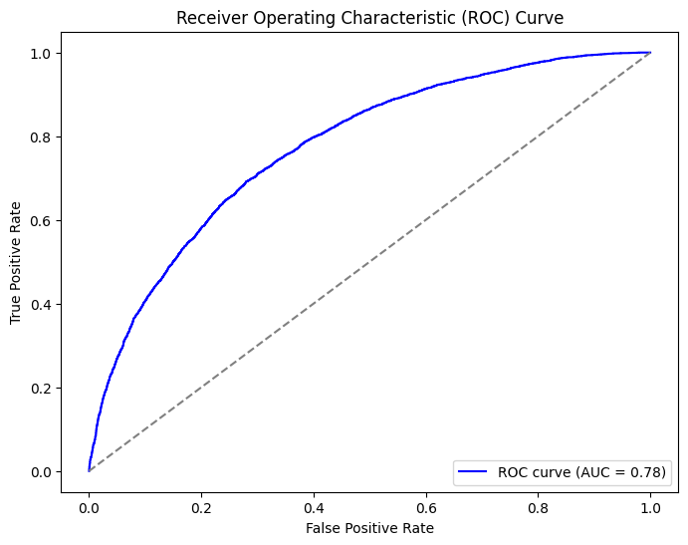
k
Upgrade
Group5
Our Goal
Random Forest
Our Goal
Data
Data
Agenda
Agenda
Lit Review
Lit Review
EDA
EDA
Feature Engineering
Feature Engineering
Modeling
Modeling
Conclusions
Gallery
Recommendations
Pricing
References
Contact Us
Notes:
Zach

Slide 28
k
Upgrade
Group5
Our Goal
Our Goal
Gradient Boosted Tree
Data
Data
Agenda
Agenda
Lit Review
Hyperparameters
N_estimators (300, 400, 500)
Number of trees in the forest
Learning_rate (0.1, 0.15, 0.2)
Step size
Max_depth (10, 11, 12)
Depth of each tree
Lit Review
EDA
EDA
Feature Engineering
Feature Engineering
Modeling
Modeling
Conclusions
Gallery
Recommendations
Pricing
References
Contact Us
Notes:
Zach

Slide 29
k
Upgrade
Group5
Our Goal
Our Goal
Gradient Boosted Tree
Data
Data
Agenda
Agenda
Results
Hyperparameters
Hyperparameters
learning_rate: 0.2
max_depth: 11
n_estimators: 500
Metric | Score
Accuracy | 0.7549
Precision | 0.7526
Recall | 0.7677
F-1 | 0.7601
Lit Review
Lit Review
EDA
EDA
Feature Engineering
Feature Engineering
Modeling
Modeling
Conclusions
Gallery
Recommendations
Pricing
References
Contact Us
Notes:
Zach

Slide 30
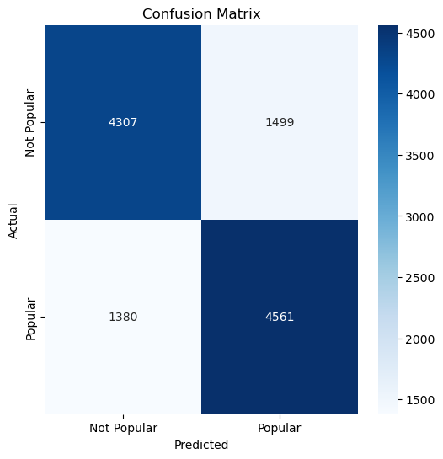
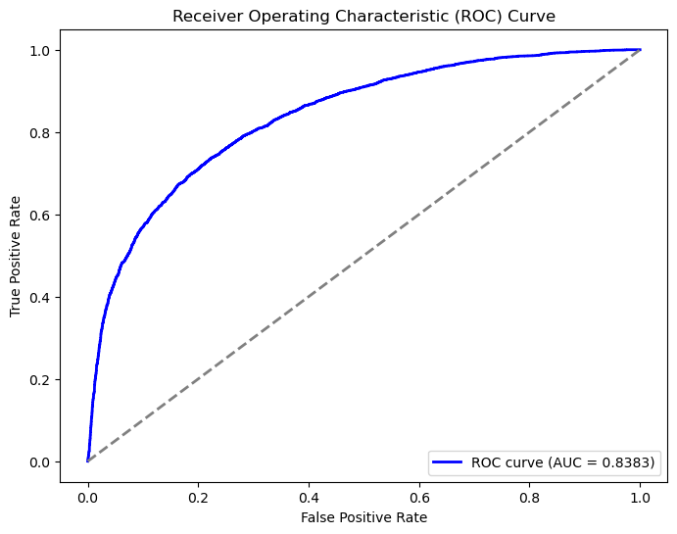
k
Upgrade
Group5
Our Goal
Our Goal
Gradient Boosted Tree
Data
Data
Agenda
Agenda
Lit Review
Lit Review
EDA
EDA
Feature Engineering
Feature Engineering
Modeling
Modeling
Conclusions
Gallery
Recommendations
Pricing
References
Contact Us
Notes:
Zach

Slide 31
k
Upgrade
Group5
Feature Importance
Our Goal
Our Goal
Data
Data
Agenda
Agenda
Model | Feature 1 | Feature 2 | Feature 3
Decision Tree | (track_genre_5.0) | (valence) | track_genre_3.0
Random Forest | (duration_ms) | (valence) | (acousticness)
Gradient Boosted Tree | (track_genre_5.0) | explicit_True | key_Eb
Lit Review
Lit Review
EDA
EDA
Feature Engineering
Feature Engineering
Modeling
Modeling
Conclusions
Gallery
Recommendations
Pricing
References
Contact Us
Notes:
Zach

Slide 32
k
Upgrade
Group5
Our Goal
Ensemble: Decision Tree + Random Forest + XGB
Our Goal
Data
Data
Agenda
Agenda
Lit Review
Metric | Score
Accuracy | 0.755
Precision | 0.7745
Recall | 0.728
F-1 | 0.7503
Lit Review
Models
Base Model
Best Gradient Boosted Tree
Best Decision Tree
Final Estimator
Best Random Forest
EDA
EDA
Feature Engineering
Feature Engineering
Modeling
Modeling
Conclusions
Gallery
Recommendations
Pricing
References
Contact Us
Notes:
Howie

Slide 33
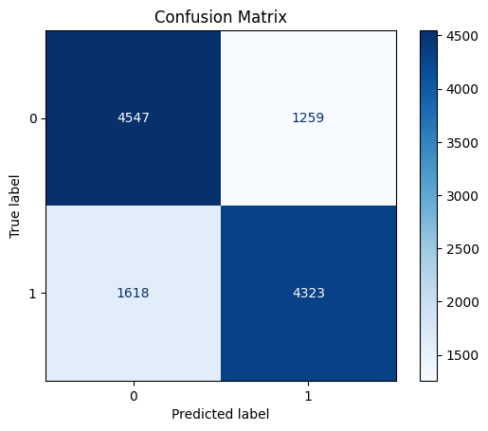
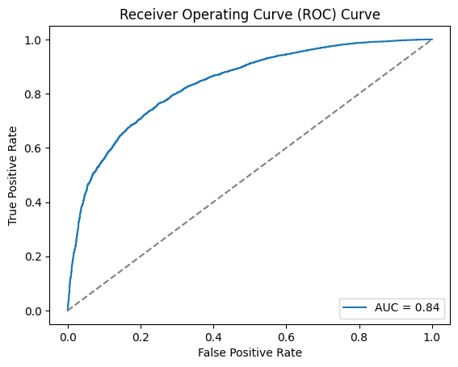
k
Upgrade
Group5
Our Goal
Our Goal
Ensemble Model
Data
Data
Agenda
Agenda
Lit Review
Lit Review
EDA
EDA
Feature Engineering
Feature Engineering
Modeling
Modeling
Conclusions
Gallery
Recommendations
Pricing
References
Contact Us
Notes:
Howie

Slide 34
k
Upgrade
Group5
Our Goal
Our Goal
Deployment
Data
Data
Agenda
Agenda
Lit Review
Lit Review
Data Collection (AWS S3)
Data Preprocessing (Airflow Automation)
Model Training (AWS SageMaker)
Model Deployment (FAST API & Docker)
API Integration (AWS Lambda)
Monitoring (Prometheus/Grafana)
End-User Interface (Streamlit/Tableau)
EDA
EDA
Feature Engineering
Feature Engineering
Modeling
Modeling
Conclusions
Conclusions
Recommendations
Recommendations
References
References
Notes:
Howie

Slide 35
k
Upgrade
Group5
Our Goal
Conclusions
Our Goal
Data
Data
Agenda
Agenda
It is possible to predict whether a song will be popular around 75 percent of the time
Sad songs (key Eb, low valence) and explicit songs are popular, confirming research about the societal shift toward negativity in music
The negative feature importance of acousticness shows the rise electronically created music which could open up the possibility of AI assisted music creation in the future
Lit Review
Lit Review
EDA
EDA
Feature Engineering
Feature Engineering
Modeling
Modeling
Conclusions
Conclusions
Recommendations
Recommendations
References
References
Notes:
Zach

Slide 36
k
Upgrade
Group5
Our Goal
Recommendations
Our Goal
Data
Data
Agenda
Agenda
Lit Review
Artists should make “sad” songs and evaluate these songs popularity versus the rest of their music
Producers can use this model to identify lesser known artists whose songs are predicted to be popular
Spotify can use this type of model to improve their recommendation algorithm by pushing songs that are determined to be popular
Lit Review
EDA
EDA
Feature Engineering
Feature Engineering
Modeling
Modeling
Conclusions
Conclusions
Recommendations
Recommendations
References
References
Notes:
Zach

Slide 37
Upgrade
Group5
k
References
Our Goal
Data
Template designed by Slidechef. (2025). [Spotify Inspired Presentation Template]. Retrieved from https://slidechef.net/templates/free-spotify-template/
Maharshi Pandya. 2022. “Spotify Tracks Dataset”. Kaggle. https://www.kaggle.com/dsv/4372070. DOI: 10.34740/KAGGLE/DSV/4372070
Batlle-Roca, Roser, Wei-Hisang Liao, Xavier Serra, Yuki Mitsufuji, and Emilia Gómez. 2024. “Towards Assessing Data Replication in Music Generation with Music Similarity Metrics on Raw Audio.” arXiv, August 1, 2024. https://doi.org/10.48550/arXiv.2407.14364.
Baym, Nancy, Rachel Bergmann, Raj Bhargava, Fernando Diaz, Tarleton Gillespie, and David Hesmondhalgh. 2021. “Making Sense of Metrics in the Music Industries.” International Journal of Communication (Online), July 2021.
Christodoulou, Anna-Maria, Olivier Lartillot, and Alexander Refsum Jensenius. 2024. “Multimodal Music Datasets? Challenges and Future Goals in Music Processing.” International Journal of Multimedia Information Retrieval, August 28, 2024. https://link.springer.com/article/10.1007/s13735-024-00344-6.
Datta, Hannes, George Knox, and Bart J. Bronnenberg. 2017. “Changing Their Tune: How Consumers’ Adoption of Online Streaming Affects Music Consumption and Discovery.” Marketing Science 37 (1): 5-21. September 11, 2017. https://doi.org/10.1287/mksc.2017.1051.
Eltringham, Jennifer. 2017. “Archiving Spotify: Methods and Motives for Collecting Individual Music Streaming Data.” Journal of Archival Organization 14 (3-4): 128-138. November 17, 2017. https://doi.org/10.1080/15332748.2018.1505386.
Guedes, David, Marília Prada, Margarida Vaz Garrido, and Elsa Lamy. 2022. “The Taste & Affect Music Database: Subjective Rating Norms for a New Set of Musical Stimuli.” Behavior Research Methods 55 (3): 1121–1140. May 17, 2022.
Kim, Seon Tae, and Joo He Oh. 2021. “Music Intelligence: Granular Data and Prediction of Top Ten Hit Songs.” Elsevier, 2021. https://www-sciencedirect-com.turing.library.northwestern.edu/science/article/pii/S0167923621000452.
Maasø, Arnt, and Anja Nylund Hagen. 2020. "Open Access: Metrics and Decision-Making in Music Streaming." Spotification of Popular Culture in the Field of Popular Communication, 64-77. September 10, 2020.
Napier, Kathleen, and Lior Shamir. 2018. "Quantitative Sentiment Analysis of Lyrics in Popular Music." Journal of Popular Music Studies 30 (4): 161–176. https://doi.org/10.1525/jpms.2018.300411.
Huang, Ruoqing. 2024. "Uncovering Audio Features Shaping Popularity in Chart-Topping Songs: A Statistical Approach." American Journal of Student Research 2 (4). December 2024. https://doi.org/10.70251/hyjr2348.24158174.
Agenda
Lit Review
EDA
Feature Engineering
Modeling
Conclusions
Recommendations
References

Slide 38


Thank You
Despacito
Luis Fonsi, Daddy Yankee
0:23
-3:25

